Slide 1
Modeling of Trap to Band Tunneling Detrapping Mechanism of 3D NAND Flash 진명

Slide 2

Elastic Tunneling Current Modeling
Elastic Tunneling Current Modeling 유도는 Appendix에서…
전체적인 modeling 식 수정 있음 (7월 자료 참고x)
Result)
Direct Tunneling
$e_{DT}=\frac{4πm}{h^{3}} 2πr_{tox1}l_{WL}\frac{{\left(kT\right)}^{2}}{1−α_{TC}×kT}\frac{n_{C}}{N_{C}}TC\left(E_{c}\right)$
Trap to Band Tunneling
$e_{TBT}=\frac{32πm}{h^{3}} {\left(l_{e}\right)}^{2}\left(N_{T}π\left(r_{tn1}^{2}−r_{tox1}^{2} \right)l_{WL}\right)\left[\frac{1}{α_{TC}^{2}} \left(\exp\left(α_{TC}Δε_{Fn}\right)−1 \right)−\frac{Δε_{Fn}}{α_{TC}^{2}}\right]TC\left(ε_{t}\right)$

Slide 3
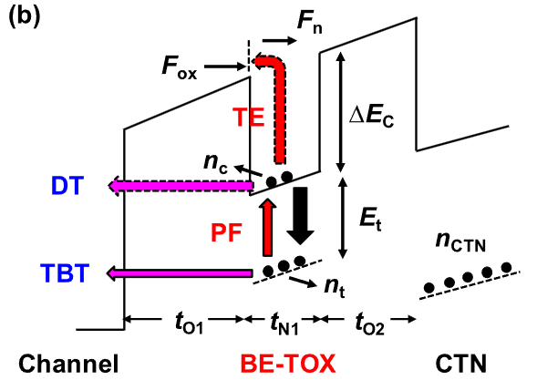


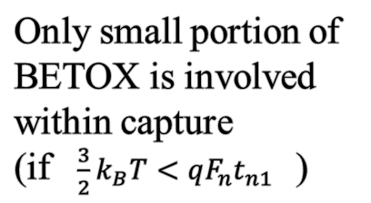
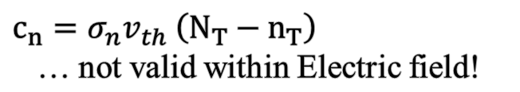


Capture Rate under High PV Level
[2] IEEE Transactions on Electron Devices 68.7 (2021): 3339-3345.
$c_{n}=σ_{n}v_{th} \left(N_{T}−n_{T}\right)$
… not valid within Electric field!
c_{n} motivation : Capture of free electron
Effective capture portion
Effective capture coefficient f_{c} < 1
Electric Force
Only small portion of BETOX is involved within capture
(if $\frac{3}{2}k_{B}T<qF_{n}t_{n1}$ )
(no capture)
$c_{n}=σ_{n}v_{th} \left(N_{T}−n_{T}\right)$
$c_{n}=σ_{n}v_{th} \left(N_{T}−n_{T}\right)×f_{c}$
Free electron capture
Electron capture in field

Slide 4
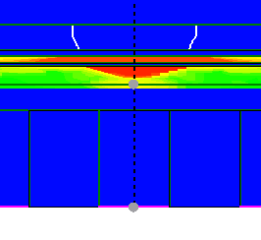
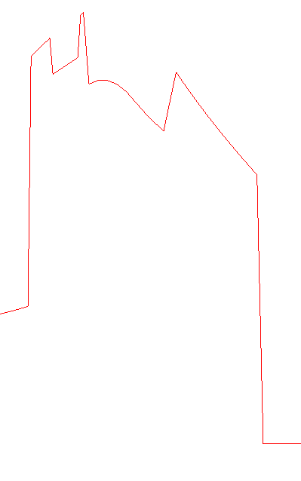

Fitting Parameter & TCAD Calibration
Fitting Parameter : V_{ch} >> Differs by PV level, set by TCAD result
1us program
0.2us program
WLT = 0V
Hole inversion due to CTN charge
hDensity high
~ 1.7 V
hDensity high
~ 0.9 V
>> V_{ch} 를 TCAD로 구한 이후 해당 PV level에서 parameter 반영

Slide 5
Model Observation
Currently applied fitting parameter :
Direct Tunneling x-sectional area coefficient, a_{DT} = 1
Trap to Band Tunneling x-sectional area coefficient, b_{TBT} = 0.3
Effective Capture coefficient, f_{c} = 0.01
E_{t} = 0.8 eV
Model
TCAD
TBT off / PF, DT on
Temperature Dependency
TBT on / PF and DT off
Temperature independent

Slide 6
Model Observation
Comparison of Model & TCAD
TBT, PF, DT on - Model
TBT, PF, DT on - TCAD
TBT dominant
TBT dominant
DT dominant
DT dominant
경향성 비슷한 상황 >> Calibration 진행 가능

Slide 7
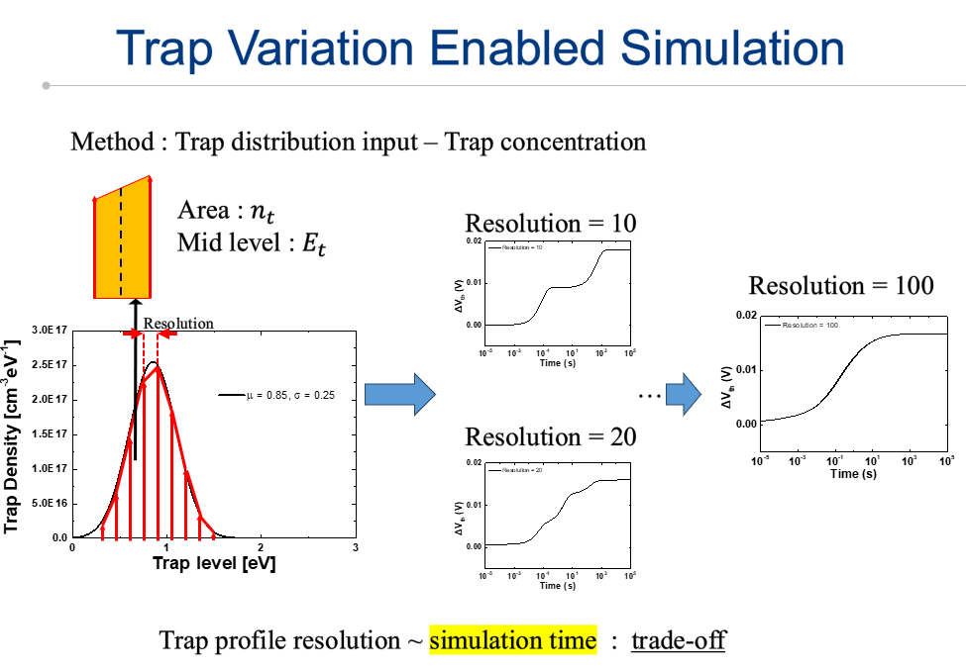
Trap Distribution Simulation
6월 연구미팅 자료
Trap Distribution Simulation
>> 그대로 적용
Et = 0.85 eV, sig = 0.25 eV, Gaussian
TBT dominant
TBT dominant
DT dominant
DT dominant

Slide 8
Future Works
Detail calibration of Parameters : a_{DT} , b_{TBT} , f_{c}
Fitting parameter 특징 분석 & 물리적 타당성
Distribution Simulation Completion

Slide 9
Appendix Elastic Tunneling 정리 진명

Slide 10
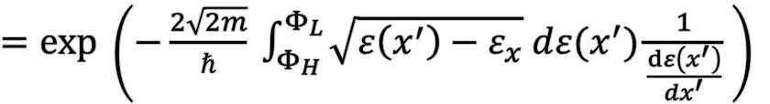




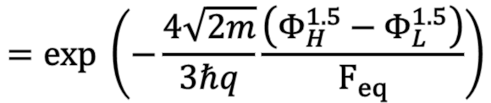

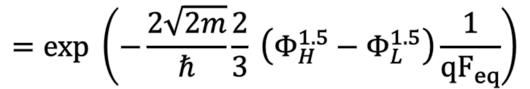
Tunneling Coefficient
The WKB Approximation
…
$TC=exp \left(−\frac{2}{ℏ} \int_{x_{1}}^{x_{2}}{\sqrt{2m \left(W\left(x^{′}\right)−ε\right)} dx′}\right)$
$\vec{F_{eq}}$
$TC=exp \left(−\frac{2\sqrt{2m}}{ℏ} \int_{0}^{x_{L}}{\sqrt{ε\left(x^{′}\right)−ε_{x}} dx^{′}}\right)$
$${qΦ}_{H}$$
$${qΦ}_{L}$$
$=exp \left(−\frac{2\sqrt{2m}}{ℏ} \int_{Φ_{H}}^{Φ_{L}}{\sqrt{ε\left(x^{′}\right)−ε_{x}} d{ε(x}^{′})\frac{1}{\frac{dε\left(x^{′}\right)}{dx^{′}}}} \right)$
$Uniform Field Assumption :\vec{F_{eq}}$
$$=exp \left(−\frac{2\sqrt{2m}}{ℏ}\frac{2}{3} \left(Φ_{H}^{1.5}−Φ_{L}^{1.5}\right)\frac{1}{{qF}_{eq}}\right)$$
$$=exp \left(−\frac{4\sqrt{2m}}{3ℏq}\frac{\left(Φ_{H}^{1.5}−Φ_{L}^{1.5}\right)}{F_{eq}}\right)$$

Slide 11
Elastic Tunneling of Electron
Main Assumption
Energy level of electron conserves in tunneling procedure
Fermi level depends on the operation of the device
At FN tunneling state, Fermi level is above the conduction band level
At retention state, Fermi level is about trap level
FN tunneling state in high current
Direct tunneling state in Retention
Excessive electron current
~ Step function
$$E_{Fn}$$
Electron gas in Conduction band
~ Boltzmann Distribution
$$E_{Fn}$$
Trapped electrons

Slide 12
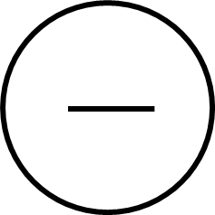

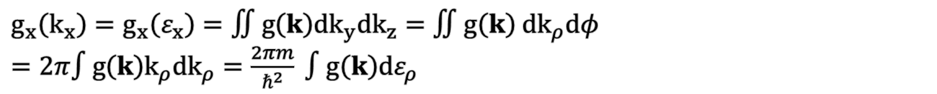


Tunneling Current Modeling
Conventional Current Density: $J=q v n$
Occupied electron state : f₁(ε)
Available electron state : 1 - f₂(ε)
$$J=q v n ⇒$$
TC
$∴ J=qvn×TC$
Area
$\left(dn_{x}=g_{x}\left(k_{x}\right) {dk}_{x}\right)$
${dJ}_{1→2}=q TC f_{1}\left(ε\right)\left(1−f_{2}\left(ε\right)\right) v_{x} {dn}_{x}= q TC\left(k_{x}\right) v_{x} g_{x}\left(k_{x}\right)f_{1}\left(ε\right)\left(1−f_{2}\left(ε\right)\right){dk}_{x}$
By quantum relation, $v_{x} {dk}_{x}=\frac{1}{ℏ} dε_{x} , k_{x} {dk}_{x}=\frac{m}{ℏ^{2}} dε_{x}, g_{x}\left(k_{x}\right)=∬g\left(k\right){dk}_{y}{dk}_{z}$
$g_{x}\left(k_{x}\right)=g_{x}\left(ε_{x}\right)=∬g\left(k\right){dk}_{y}{dk}_{z}=∬g\left(k\right) {dk}_{ρ}dφ$
$=2π∫g\left(k\right)k_{ρ}{dk}_{ρ}=\frac{2πm}{ℏ^{2}} ∫g\left(k\right)dε_{ρ}$

Slide 13
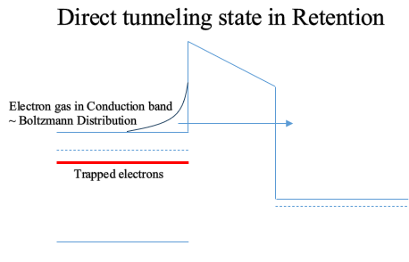

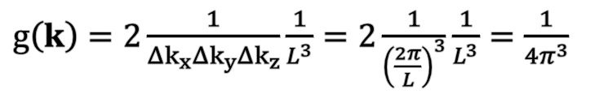


Direct Tunneling
${dJ}_{1→2}=q TC\left(ε_{x}\right)v_{x}{dn}_{x}=qTC\left(ε_{x}\right)v_{x}g_{x}\left(k_{x}\right)f_{1}\left(ε\right)\left(1−f_{2}\left(ε\right)\right){dk}_{x}$
$g\left(k\right)=2\frac{1}{Δk_{x}Δk_{y}Δk_{z}}\frac{1}{L^{3}}=2\frac{1}{{\left(\frac{2π}{L}\right)}^{3}}\frac{1}{L^{3}}=\frac{1}{{4π}^{3}}$
DoS of periodic space
$⇒ g_{x}\left(k_{x}\right)=\frac{2πm}{ℏ^{2}} ∫g\left(k\right)dε_{ρ}$
$J=q\frac{4πm}{h^{3}} ∫TC\left(ε_{x}\right)N\left(ε_{x}\right) dε_{x}$ : Duke’s Tunneling Current Model
$$TC(ε):Tunneling Coefficient , N\left(ε\right):Supply Function$$
Quasi-Fermi level
$\left(E_{Fn}=E_{C} −kT ln \left(\frac{n_{C}}{N_{C}}\right)\right)$
$N\left(ε_{x}\right)=\int_{0}^{∞}{f_{1} \left(ε\right) \left(1−f_{2}\left(ε\right)\right) dε_{ρ}}=\int_{0}^{∞}{exp\left(−\frac{ε_{x}+ε_{ρ}−E_{Fn}}{kT}\right) dε_{ρ}}=kT exp\left(−\frac{ε_{x}−E_{Fn}}{kT}\right)$
$$e_{DT}=\frac{J}{q}×\left(Area\right) \int_{E_{c}}^{∞}{TC\left(ε_{x}\right) kT exp(− \frac{ε_{x}−E_{Fn}}{kT}) dε_{x}}$$

Slide 14

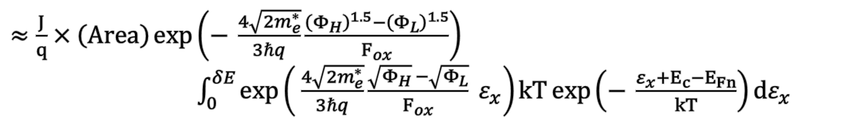


Direct Tunneling
$e_{DT}=\frac{J}{q}×\left(Area\right) \int_{E_{c}}^{∞}{TC\left(ε_{x}\right) kT exp(− \frac{ε_{x}−E_{Fn}}{kT}) dε_{x}}$
$≈ \frac{J}{q}×\left(Area\right) \int_{0}^{δE}{TC\left(ε_{x}\right) kT\exp\left(− \frac{ε_{x}+E_{c}−E_{Fn}}{kT}\right)dε_{x}} \left(δE≪E_{c}−ε_{x}\right)$
$≈\frac{J}{q}×\left(Area\right)\int_{0}^{δE}{\exp\left(− \frac{4\sqrt{2m_{e}^{∗}}}{3ℏq}\frac{{\left(Φ_{H}−ε_{x}\right)}^{1.5}−{\left(Φ_{L}−ε_{x}\right)}^{1.5}}{F_{ox}}\right) kT\exp\left(− \frac{ε_{x}+E_{c}−E_{Fn}}{kT}\right)dε_{x}}$
$≈\frac{J}{q}×\left(Area\right)\exp\left(− \frac{4\sqrt{2m_{e}^{∗}}}{3ℏq}\frac{{\left(Φ_{H}\right)}^{1.5}−{\left(Φ_{L}\right)}^{1.5}}{F_{ox}}\right)$
$\int_{0}^{δE}{\exp\left( \frac{4\sqrt{2m_{e}^{∗}}}{3ℏq}\frac{\sqrt{Φ_{H}} −\sqrt{Φ_{L}}}{F_{ox}} ε_{x}\right)kT\exp\left(− \frac{ε_{x}+E_{c}−E_{Fn}}{kT}\right)dε_{x}}$
TC(E_{C})
$α_{TC}$
$≈\frac{4πm}{h^{3}} \left(2πr_{tox1}l_{WL} a\right) TC\left(E_{c}\right)\frac{{\left(kT\right)}^{2}}{1−α_{TC}×kT}exp \left(−\frac{E_{c}−E_{Fn}}{kT}\right)$
a: Area correction parameter (default = 1)
$=\frac{n_{C}}{N_{C}}$
$e_{DT}=\frac{4πm}{h^{3}} 2πr_{tox1}l_{WL}\frac{{\left(kT\right)}^{2}}{1−α_{TC}×kT}\frac{n_{C}}{N_{C}}TC\left(E_{c}\right)$

Slide 15
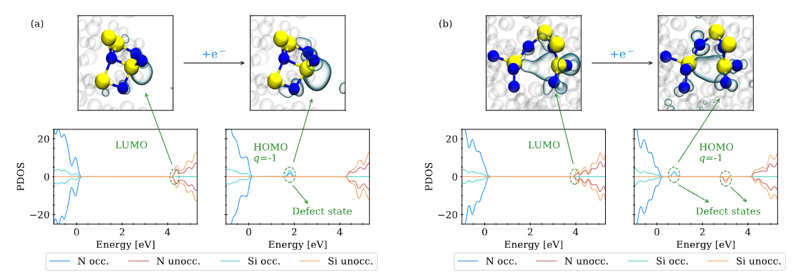

Localization of Trapped Electron
Wilhelmer, Christoph, et al. Nanomaterials 13.16 (2023): 2286.
Trapped electron is localized within the trap nitride device structure.
~0.1Å
$$l_{e}$$
: Trapped electron modeled as Aperiodic cubit trap site
(cf. cubit in size of atom, finite potential well)

Slide 16
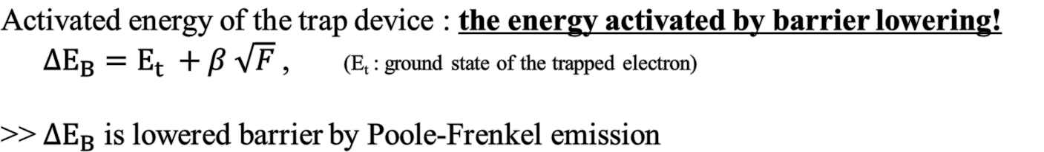
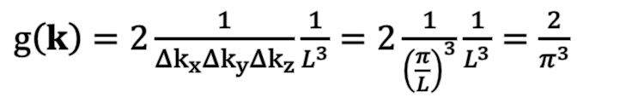
Trap to Band Tunneling
${dJ}_{1→2}=q TC\left(ε_{x}\right)v_{x}{dn}_{x}=qTC\left(ε_{x}\right)v_{x}g_{x}\left(k_{x}\right)f_{1}\left(ε\right)\left(1−f_{2}\left(ε\right)\right){dk}_{x}$
$g\left(k\right)=2\frac{1}{Δk_{x}Δk_{y}Δk_{z}}\frac{1}{L^{3}}=2\frac{1}{{\left(\frac{π}{L}\right)}^{3}}\frac{1}{L^{3}}=\frac{2}{π^{3}}$
Assumption:
Trap = Aperiodic potential well
DoS of aperiodic cubit
$J=q\frac{4m}{{π^{2}ℏ}^{3}} ∫TC\left(ε_{x}\right)N\left(ε_{x}\right) dε_{x}$ : Trap-to-Band Tunneling Current Model
Activated energy of the trap device : the energy activated by barrier lowering!
${ΔE}_{B}=E_{t} +β \sqrt{F}$ , (E_{t} : ground state of the trapped electron)
>> ${ΔE}_{B}$ is lowered barrier by Poole-Frenkel emission

Slide 17






Trap to Band Tunneling
$J=q\frac{4m}{{π^{2}ℏ}^{3}} ∫TC\left(ε_{x}\right)N\left(ε_{x}\right) dε_{x}$ : Trap-to-Band Tunneling Current Model
$N\left(ε_{x}\right)=∫f_{1}\left(ε\right) \left(1−f_{2}\left(ε\right)\right) dε_{ρ} ≈∫f_{1}\left(ε\right) dε_{ρ}=\left\{\begin{aligned}{Δε}_{B} −ε_{x} \left(0<ε_{x}<{Δε}_{B}\right) \\ 0 \left(ε_{x}>{Δε}_{B}\right)\end{aligned}\right.$
${Δε}_{B}$ : Lowered Barrier (by Poole-Frenkel)
~0.1Å
$$l_{e}$$
(maximum state of trapped electron)
TC
$${Δε}_{B}$$
Effective Area : $l_{e}^{2}={\left(λ_{e}b\right)}^{2}$
$ε_{t}$
Trap to Band Tunneling
(ground state of trapped electron)
$λ_{e}$ : electron matter wavelength
b : volume correction parameter
$e_{TBT}= ν_{TBT}×TC=\frac{J}{q}×\left(l_{e}^{2}\right)×\left(\# of traps\right)×\int_{0}^{{Δε}_{B}}{TC\left(ε_{x}\right)\left({Δε}_{B}−ε_{x}\right) dε_{x}}$

Slide 18
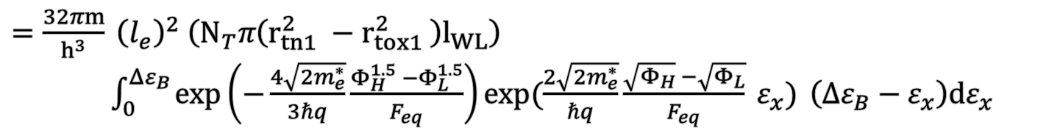
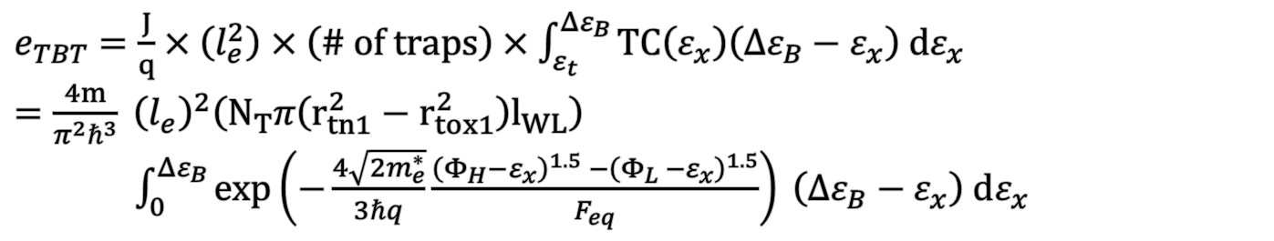

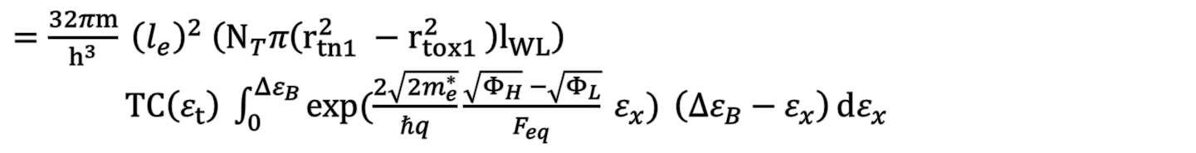
Trap to Band Tunneling
$e_{TBT}=\frac{J}{q}×\left(l_{e}^{2}\right)×\left(\# of traps\right)×\int_{ε_{t}}^{{Δε}_{B}}{TC\left(ε_{x}\right)\left({Δε}_{B}−ε_{x}\right) dε_{x}}$
$=\frac{4m}{π^{2}ℏ^{3}} {\left(l_{e}\right)}^{2}\left(N_{T}π\left(r_{tn1}^{2}−r_{tox1}^{2}\right)l_{WL}\right)$
$\int_{0}^{{Δε}_{B}}{\exp\left(−\frac{4\sqrt{2m_{e}^{∗}}}{3ℏq}\frac{{\left(Φ_{H}−ε_{x}\right)}^{1.5} −{\left(Φ_{L} −ε_{x}\right)}^{1.5}}{F_{eq}}\right) \left({Δε}_{B}−ε_{x}\right) dε_{x} }$
$=\frac{32πm}{h^{3}} {\left(l_{e}\right)}^{2} \left(N_{T}π\left(r_{tn1}^{2} −r_{tox1}^{2} \right)l_{WL}\right)$
$\int_{0}^{{Δε}_{B}}{\exp\left(−\frac{4\sqrt{2m_{e}^{∗}}}{3ℏq}\frac{Φ_{H}^{1.5} −Φ_{L}^{1.5}}{F_{eq}}\right)\exp{(\frac{2\sqrt{2m_{e}^{∗}}}{ℏq}\frac{\sqrt{Φ_{H}} −\sqrt{Φ_{L}}}{F_{eq}} ε_{x})} \left({Δε}_{B}−ε_{x}\right)dε_{x}}$
$$TC\left(ε_{t}\right)$$
$=\frac{32πm}{h^{3}} {\left(l_{e}\right)}^{2} \left(N_{T}π\left(r_{tn1}^{2} −r_{tox1}^{2} \right)l_{WL}\right)$
$TC\left(ε_{t}\right) \int_{0}^{{Δε}_{B}}{\exp{(\frac{2\sqrt{2m_{e}^{∗}}}{ℏq}\frac{\sqrt{Φ_{H}} −\sqrt{Φ_{L}}}{F_{eq}} ε_{x})} \left({Δε}_{B}−ε_{x}\right){dε_{x}}}$

Slide 19
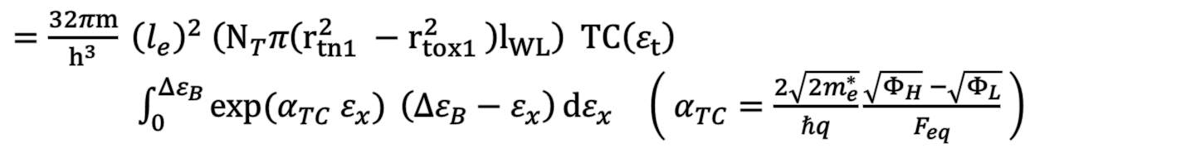

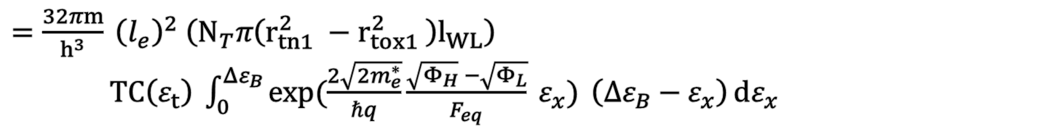

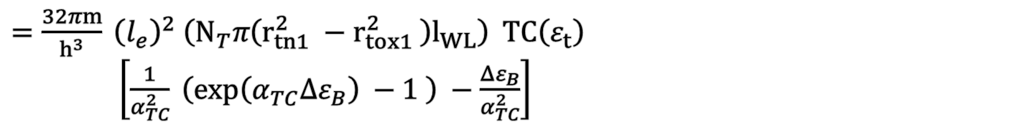
Trap to Band Tunneling
$=\frac{32πm}{h^{3}} {\left(l_{e}\right)}^{2} \left(N_{T}π\left(r_{tn1}^{2} −r_{tox1}^{2} \right)l_{WL}\right)$
$TC\left(ε_{t}\right) \int_{0}^{{Δε}_{B}}{\exp{(\frac{2\sqrt{2m_{e}^{∗}}}{ℏq}\frac{\sqrt{Φ_{H}} −\sqrt{Φ_{L}}}{F_{eq}} ε_{x})} \left({Δε}_{B}−ε_{x}\right){dε_{x}}}$
$=\frac{32πm}{h^{3}} {\left(l_{e}\right)}^{2} \left(N_{T}π\left(r_{tn1}^{2} −r_{tox1}^{2} \right)l_{WL}\right) TC\left(ε_{t}\right)$ $\int_{0}^{{Δε}_{B}}{\exp{(α_{TC} ε_{x})} \left({Δε}_{B}−ε_{x}\right){dε_{x}}}$ $\left( α_{TC}=\frac{2\sqrt{2m_{e}^{∗}}}{ℏq}\frac{\sqrt{Φ_{H}} −\sqrt{Φ_{L}}}{F_{eq}} \right)$
$=\frac{32πm}{h^{3}} {\left(l_{e}\right)}^{2} \left(N_{T}π\left(r_{tn1}^{2} −r_{tox1}^{2} \right)l_{WL}\right) TC\left(ε_{t}\right)$
$\left[\frac{1}{α_{TC}^{2}} \left(\exp\left(α_{TC}{Δε}_{B}\right) −1 \right) −\frac{{Δε}_{B}}{α_{TC}^{2}}\right]$
$e_{TBT}=\frac{32πm}{h^{3}} {\left(l_{e}\right)}^{2}\left(N_{T}π\left(r_{tn1}^{2}−r_{tox1}^{2} \right)l_{WL}\right)\left[\frac{1}{α_{TC}^{2}} \left(\exp\left(α_{TC}{Δε}_{B}\right)−1 \right)−\frac{{Δε}_{B}}{α_{TC}^{2}}\right]TC\left(ε_{t}\right)$
$${⇒ν}_{TBT}$$
$=ν_{TBT}×TC \left(ε_{t}\right)$

Slide 20
Trap to Band Tunneling
Idea of the modeling
Conventional TBT
Proposed TBT
TC
TC
TC
TC
TC
Tunneling current
Trap 된 전자들은 모두 동일한 tunneling current
각각의 전자들이 별개로 움직임

Slide 21

Final Result
Direct Tunneling
$e_{DT}=\frac{4πm}{h^{3}} 2πr_{tox1}l_{WL}\frac{{\left(kT\right)}^{2}}{1−α_{TC}×kT}\frac{n_{C}}{N_{C}}TC\left(E_{c}\right)$
Trap to Band Tunneling
$e_{TBT}=\frac{32πm}{h^{3}} {\left(l_{e}\right)}^{2}\left(N_{T}π\left(r_{tn1}^{2}−r_{tox1}^{2} \right)l_{WL}\right)\left[\frac{1}{α_{TC}^{2}} \left(\exp\left(α_{TC}Δε_{Fn}\right)−1 \right)−\frac{Δε_{Fn}}{α_{TC}^{2}}\right]TC\left(ε_{t}\right)$

